Slide 1
Luxury Housing Sales Analysis – Bengaluru
Project Explanation Summary

Slide 2
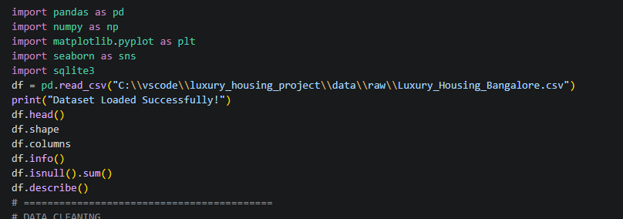
Project Objective
The main objective of this project is to analyze luxury housing sales data in Bengaluru and identify:
top-performing developers
high revenue micro markets
buyer behavior
sales trends
property demand patterns
using:
Python
SQL (SQLite)
Power BI.

Slide 3
Data Set understanding
The dataset contains:
property details
developer information
pricing
buyer type
amenities
traffic score
connectivity score
sales channels
quarterly sales data
Total records – 101000 rows

Slide 4
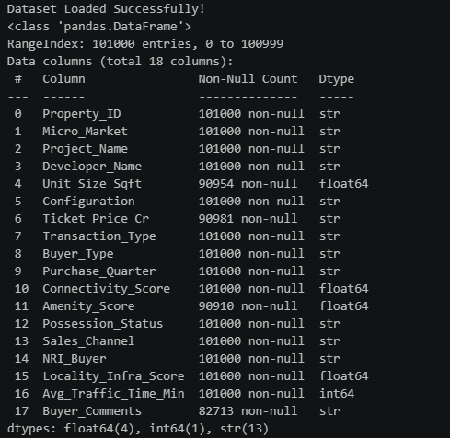
Data cleaning
I used Pandas for date pre-processing
Cleaning steps:
checked missing values
removed invalid values
handled null records
converted data types
cleaned price column
treated outliers
Example - df.isnull().sum()
df.describe()

Slide 5
Feature Engineering
New columns were created to improve analysis.
Examples:
Property_Category
Traffic_Category
Amenity_Category
NRI_Flag
Purpose: to make raw data easier for business analysis and visualization.

Slide 6
Exploratory Data Analysis (EDA)
Matplotlib
Seaborn to identify patterns and trends.
Analysis Performed:
top developers by revenue
configuration demand
micro market performance
buyer distribution
quarterly sales trend
traffic vs pricing analysis
Purpose: to extract meaningful business insights from the dataset.

Slide 7
SQL Integration (SQLite)
I integrated SQLite database using Python.
Steps:
created SQLite connection
stored cleaned dataset into SQL table
executed SQL queries for analysis
Purpose: to simulate real-world database storage and querying process.

Slide 8
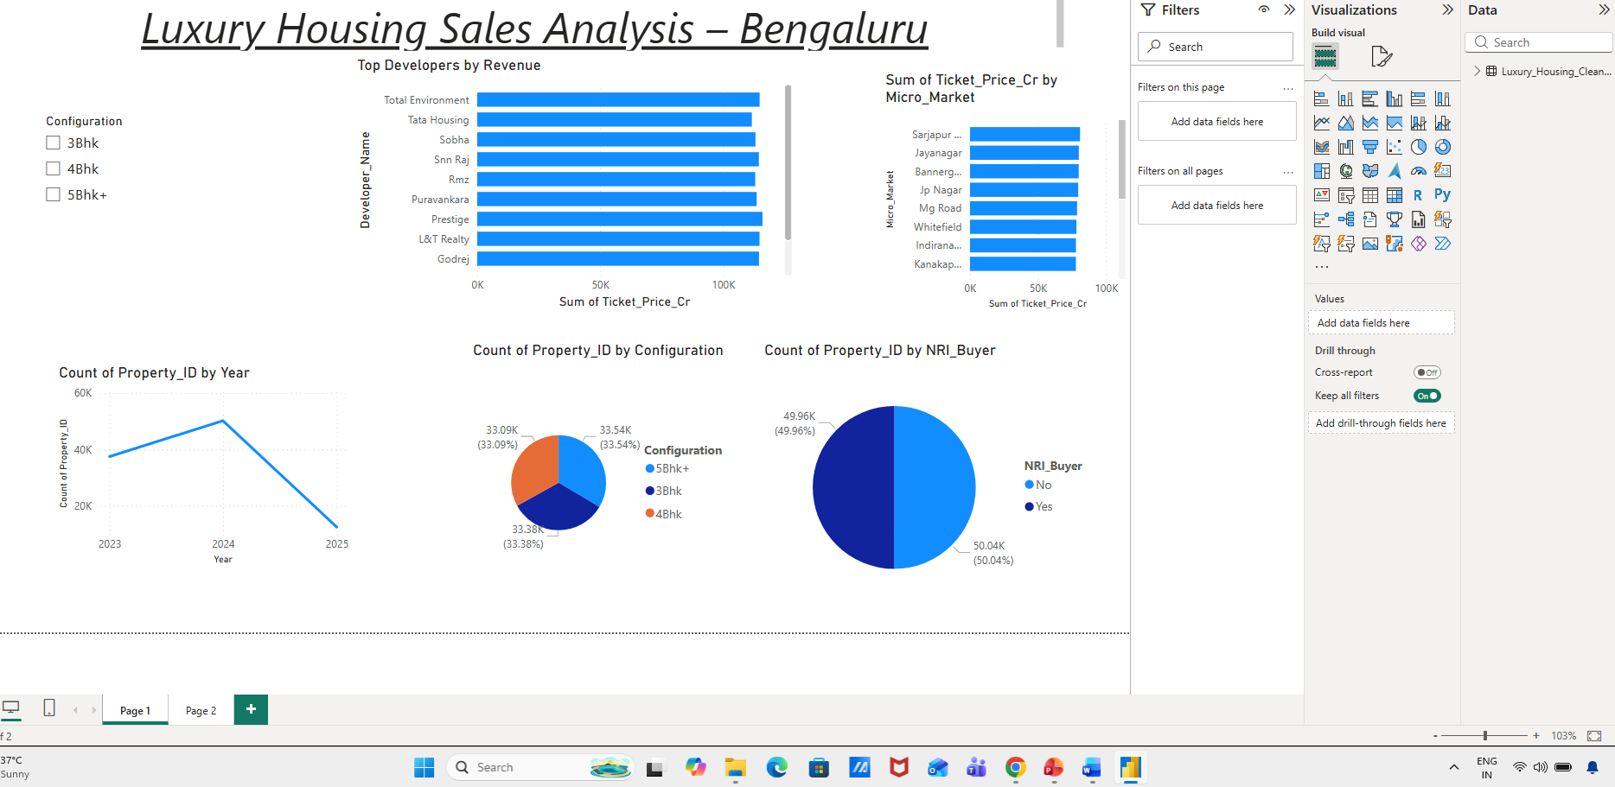
Power BI Dashboard
Created an interactive dashboard using Power BI.
Dashboard Includes:
developer revenue analysis
configuration demand pie chart
quarter-wise sales trend
NRI buyer analysis
micro market revenue analysis
slicers for filtering
Purpose: to visualize insights interactively for business users.

Slide 9
Key Insights
Some important findings:
certain developers generated higher revenue
specific micro markets had stronger sales
3BHK/4BHK configurations showed high demand
NRI buyers contributed significantly
sales varied across quarters

Slide 10
Conclusion
This project demonstrates:
end-to-end data analytics workflow
ETL process
SQL integration
dashboard reporting
business insight generation

